Slide 1

Technology Fundamentals with C#
Course Introduction
SoftUni Team
Technical Trainers
Software University
https://softuni.bg/

Slide 2
Table of Contents
Course Objectives
Training and Team
Course Organization
Course Infrastructure
Evaluation Criteria

Slide 3
Have a Question?
sli.do
#tech-csharp

Slide 4

Course Objectives

Slide 5
Technology Fundamentals Objectives
Working with linear data structures
Arrays and Lists
Defining simple classes
Processing and manipulating strings
Building simple web projects
Performing basic CRUD operations

Slide 6
Practical Programming Exam
Mid Exam
3 practical problems for 4 hours
Conditional Statements and Loops
Linear Data Structures – Arrays and Lists
Final Exam
2 practical problems for 4 hours + 2 hours evaluation
Strings and Text Processing
Associative Arrays
Web Project – Basic CRUD

Slide 7

Exam Demonstration

Slide 8

The Team

Slide 9
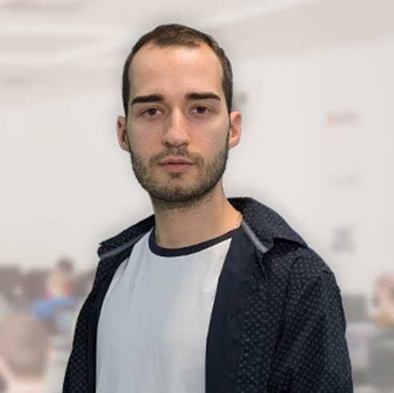
Nikolay Kostov
Solutions Architect @ ZenCodeo
15+ years in the IT
Developer, Manager, Trainer, Architect
Аctive role in the development of the Judge platform - https://judge.softuni.bg/
Microsoft Certified Trainer
Personal blog: nikolay.it

Slide 10
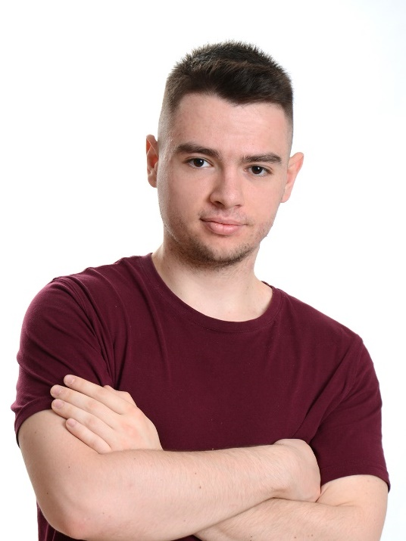
Atanas Atanasov
C# Program Lead @ SoftUni
Passionate trainer
Interested in Web Development

Slide 11
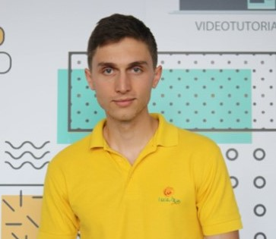
Ivaylo Dimitrov
4+ years experience in the IT (HTML, CSS, JavaScript, C#, SQL, Windows Server)
Excellent Software University student
Technical Trainer in Software University

Slide 12

Course Organization

Slide 13
Technology Fundamentals with C # Module
21-Jan-2019
14-Apr-2019
18-Apr-2019
Tech – C#
12 weeks * 3 times / week
18 credits
Start: 21-Jan-2019
Mid Exam: 10-Mar-2019
Final exam: 14-Apr-2019
Re-Take Exams
Mid Exam Retake: 16-Apr-2019
Final Exam Retake : 18-Apr-2019

Slide 14

Homework Assignments & Exercises
Your homework is mainly work in class
Lesson days → slides + live demos + exercises
Exercise days → only exercises
How to submit your homework?
Submitted in the judge system
Do your homework when it's due
Assignments pile up quickly

Slide 15


Scoring System for the Course
Mandatory:
Exam – 90%
Mid exam – 40%
Final exam – 60%
Exercises & homework – 10%
Bonuses:
Presence in class – 5% bonus (onsite students only)
Forum activity – bonus up to 5%

Slide 16



Course Web Site, Forum and FB Group
Official web site:
Official discussion forum:
Official Facebook group:
https://softuni.bg/tech-module-4-0
https://softuni.bg/forum
https://www.facebook.com/TechModuleJanuary2019/

Slide 17


The Free C# Fundamentals Textbook
The official textbook for the course
"Fundamentals of Computer Programming with C#", by Svetlin Nakov & Co., 2013, ISBN 9789544007737
English and Bulgarian versions (as PDF, ePub, …)
Freely downloadable from: www.introprogramming.info
The Technology Fundamentals courses @SoftUni.bg partially follows the book

Slide 18
https://softuni.bg/trainings/courses

Slide 19












SoftUni Diamond Partners

Slide 20




SoftUni Organizational Partners

Slide 21




Trainings @ Software University (SoftUni)
Software University – High-Quality Education and Employment Opportunities
softuni.bg
Software University Foundation
http://softuni.foundation/
Software University @ Facebook
facebook.com/SoftwareUniversity
Software University Forums
forum.softuni.bg

Slide 22

License
This course (slides, examples, demos, videos, homework, etc.) is licensed under the "Creative Commons Attribution-NonCommercial-ShareAlike 4.0 International" license

